Slide 1
Chapter (7)
Planning

Slide 2
Introduction
Planning is not something very recent, but has evolved over the years because of two factors:
Planning has indeed become specialized, being applied to more and more aspects of our business and personal lives.
ii) While planning was once an activity in which one engaged in order to get through crisis situations or to fill unoccupied time, now it is clearly recognized as a task essential to business and personal well being.

Slide 3
Definition
Planning is a process that involves the determination of any future course of action, i.e. why take an action, what action, how to take action and when to take action.
These why, what, how and when are related with different aspects of the planning process. All these aspects are the parts of the process which determines in advance the future accomplishments and the means to achieve them

Slide 4
Features of planning
A process rather than behavior at a given point of time. It is the process which determines the future course of action.
Concerned basically with the future and requires forecasting of the future situation. ; the process of selection of a suitable course of action keeping in view the available resources.
Not restricted to a certain section of the organization but is undertaken at all levels. This is because all levels of management are concerned with the determination of the future course of action.
Flexible as commitment is based on future conditions which are always dynamic. As such an adjustment is needed between the various factors and planning.
Pervasive and continuous management function involving complex processes of perception, analysis, conceptual thought, decision and action.

Slide 5
Advantages of planning
You can direct the activities in an orderly way for achieving the goal.
Unproductive work and wastage can be minimized.
Proper resource allotment can be done,
Better utilization of available resources is possible,
Problems and competition, etc. can be anticipated,
Things can be looked at in totality, etc,

Slide 6
Challenges of planning
Predictions cannot always be accurate.
Planning makes you work in a preconceived framework and discourages initiative and innovation.
Planners overdo their job; some feel planning is only theoretical, etc.
You should remember that the magnitude of planning is too vast in managerial tasks.
You need a plan to organize, mobilize, allocate, operationalize, finance, market compete, monitor, control, improve, change or innovate, etc.

Slide 7
Types of plans
i) Strategic plans
ii) Operational or Tactical plans
Strategic plans are devised to meet the organizational goals whereas, operational plans are devised to implement the strategic plans.
However, above all these is the mission statement which defines the organization's goals.

Slide 8
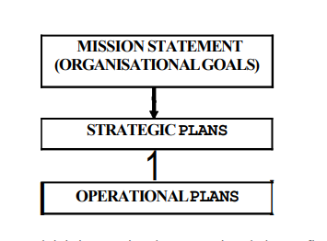
Types of plans

Slide 9
Types of plans
Strategic plans
Strategic plans decide the aims and policies of the organization.
For formulating a strategic plan you can begin with asking the following questions:
What service is to be provided by you?
What sort of competition do you have?
What are the resources and infrastructural needs?
What kind of social, economic or political environment is there?
What unique features you offer? etc.

Slide 10
Types of plans
Operational planning determines the tasks to be accomplished, determines responsibility, allocates resources and sets measurements for every task.

Slide 11
Types of plans
Besides these two types of plans, there are certain other types of plans dealt with by managers in their routine.
These may involve individual activity, departmental activity or entire organizational activity.
Such plans are related to policy matters, procedures, methodologies, quality assurance, budgets, projects or technologies.

Slide 12
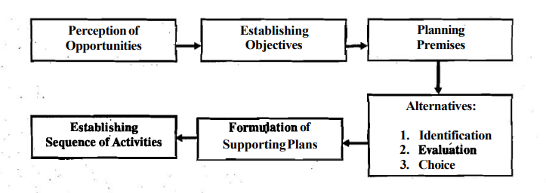
Steps of planning

Slide 13
Steps of planning
1) Perception of Opportunities:
It includes:
A preliminary look at possible opportunities and the ability to see them clearly and completely,
A knowledge of where the organization stands in the light of its strength and weaknesses,
An understanding of why the organization wants to solve uncertainties, and a a vision of what is expected to be gained.

Slide 14
Steps of planning
2) Establishing Objectives:
Major organizational and unit objectives are set at this stage. They specify the results expected and indicate the end points of:
What is to be done,
Where the primary emphasis is to be placed,
What is to be accomplished by various types of plans.

Slide 15
Steps of planning
3) Planning Premises:
Planning premises are planning assumptions - the expected environment and internal conditions.
Thus planning premises are both, external as well as internal:
External premises include total factors in task environment like political, social, technological, competitors' plans and actions, government policies, etc.
Internal factors include the organization's policies, resources of various types and the ability of the organization to withstand the environmental pressures.

Slide 16
Steps of planning
4) Identification of Alternatives:
At this stage, various alternatives are identified based on the organizational objectives and planning premises.
The selected alternatives are then reduced so that the most promising ones may be taken for detailed analysis.
The concept of various alternatives suggests that a particular objective can be achieved through various actions.

Slide 17
Steps of planning
5) Evaluation of Alternatives:
At this stage, an attempt is made to evaluate how each alternative contributes to the organizational objectives in the light of its resources and constraints.

Slide 18
Steps of planning
6) Choice of Alternatives:
Once the alternatives are evaluated, the one which fits best in the organization is selected.
In case, of more than one alternative fitting the organizational needs and constraints, the planner should choose more than one alternative.
This provides the flexibility to the plan and the contingency plan (i.e. the alternate plan) can be implemented in changed situations.
7) Formulation of Supporting Plans:
Once the basic plan is formulated, various plans are derived so as to support the main plan.
These derivative plans are formulated out of the main plan and, therefore, they support it.

Slide 19
Steps of planning
8) Establishing Sequence of Activities:
After formulating the basic and derivative plans, the sequence of activities is determined so that plans are put into action.

